Slide 1
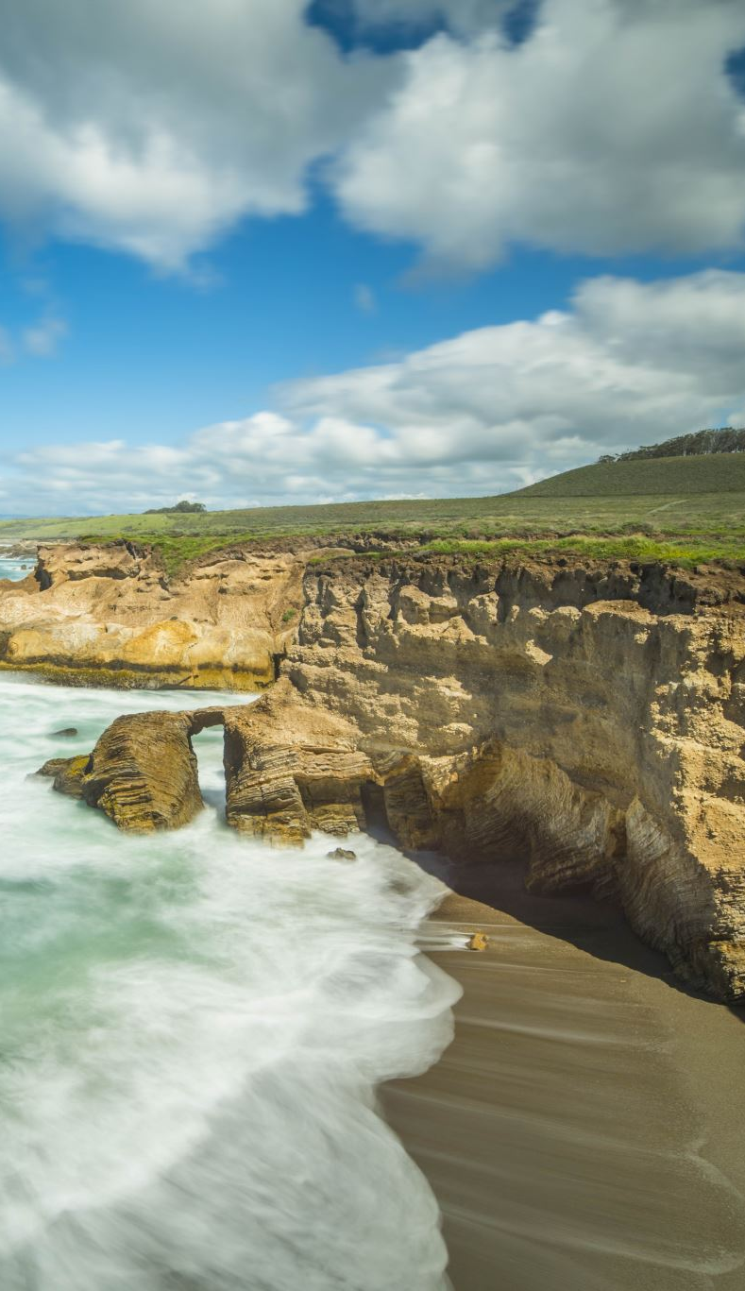

Underwater Image Enhancement (Based On Colour Correction and Fusion Techniques for blue/green colour deviated Underwater images )
Presented by-
Piyush Priyadarshi
(BT17EC006)
Dept. Of Electronics & Comm. Engineering
NIT Mizoram
Under the Supervision of-
Dr. Chaitali Koley
(Assistant Professor)
Dept. Of Electronics & Comm. Engineering
NIT Mizoram
Department of Electronics and Communication Engineering
NATIONAL INSTITUTE OF TECHNOLOGY MIZORAM (May 2020)

Slide 2
Contents
1. Introduction
2. Our Model for Underwater Image Enhancement
2.1 Our Objective
3. Results and Qualitative Evaluation
4. Applications
2.3 Image Fusion Algorithm
5. References
3.1 Some Results of our Model.
3.2 Qualitative Analysis
1.1 Propagation of Light in the Water
1.2 Under Water Image Formation Model
2.2 Color Correction Based on White-Balancing
2.4 Multi-Scale Fusion Process
1.3 Types of Under Water Images

Slide 3
Introduction
Underwater environment offers many rare attractions such as marine animal, fishes, amazing landscape and shipwrecks. Underwater imaging has conjointly been a very important supply in numerous branches of technology and scientific researches like examination of underwater infrastructures , detection of manmade objects, control of underwater vehicles, marine biology research, and archeology . It is well known that underwater image processing differs extensively from visual image processing, primarily due to three major underwater channel impairments, i.e., absorption, scattering and refraction. These factors, responsible for introduction of noise, color cast, low contrast and lower brightness.

Slide 4
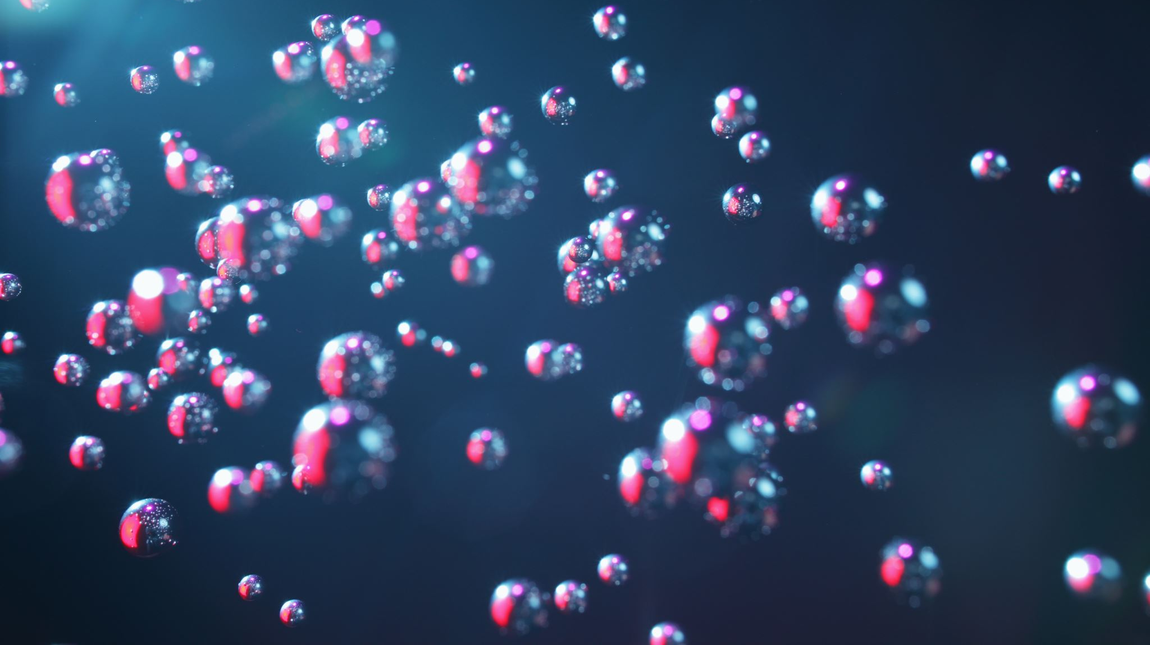
1.1 Propagation of Light in the Water
Light interacts with the water medium through two processes: absorption and scattering. Absorption is the loss of power as light travels in the medium and it depends on the index of refraction of the medium. Scattering refers to any deflection from a straight-line propagation path. In underwater environment, deflections can be due to particles of size comparable to the wavelengths of travelling light (diffraction), or to particulate matter with refraction index different from that of the water (refraction).

Slide 5
Figure 1.1: The three components of underwater optical imaging: direct component (straight line), forward component (dashed line) and backward scatter component (dash-dot line).

Slide 6
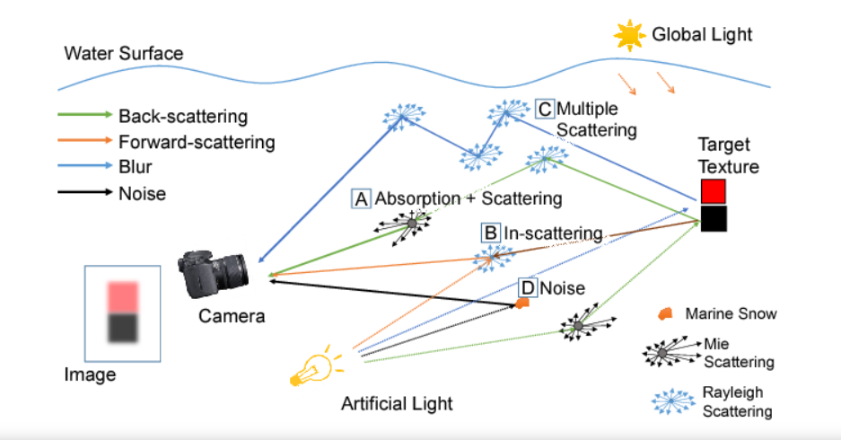
1.2 Under Water Image Formation Model
Figure 1.2: Under Water Image Formation Model

Slide 7
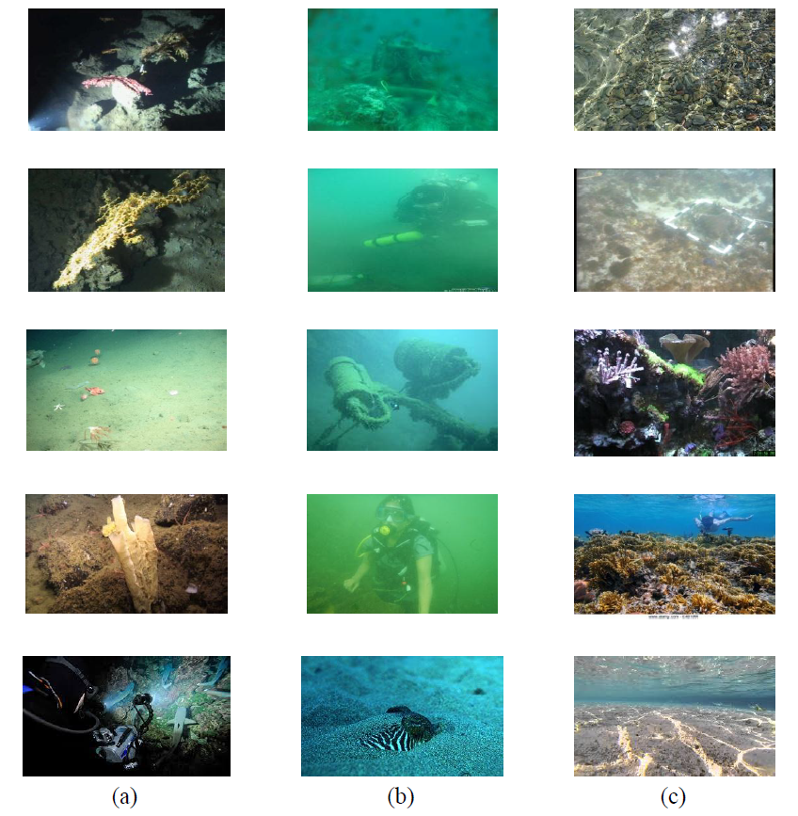
1.3 Types of Under Water Images
Figure 1.3 (a) Image with Artificial Light Source (b) Blue/Green colour Deviated Images
(c) Natural Light Source Shallow water Image

Slide 8
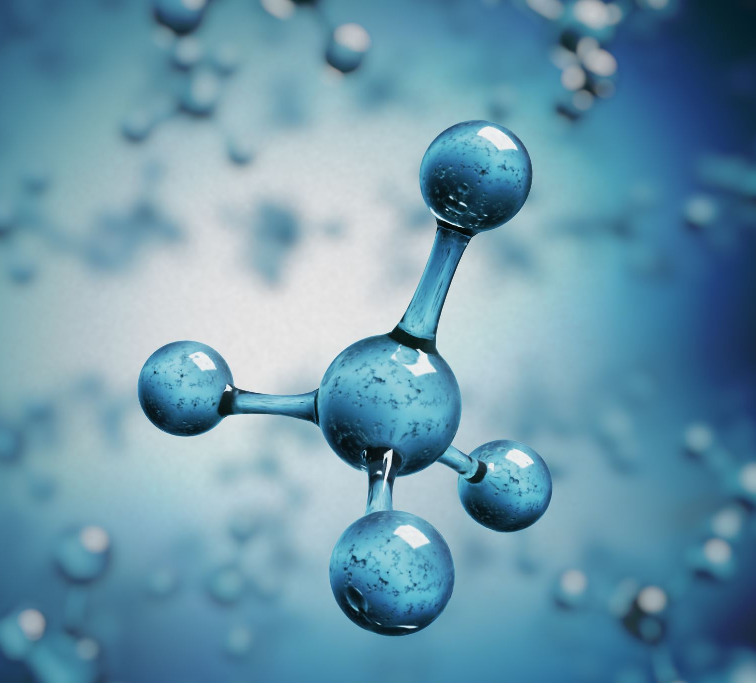
Our Model for Underwater Image Enhancement
2.1 Our Objective
Our Main objective is two fix two main issues with the underwater images i.e., color deviation and poor visibility, our model will fix these issue with underwater images.

Slide 9
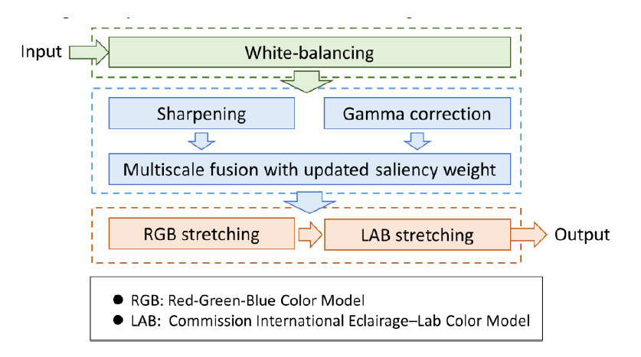
Figure 2.1. Our Method overview.

Slide 10
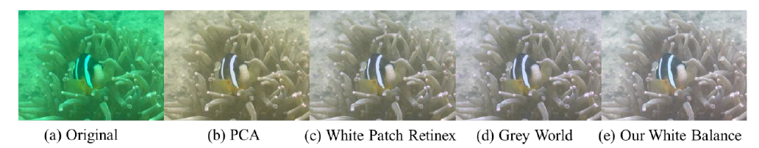
2.2 White Balancing Algorithm
White-balancing aims at improving the image aspect, primarily by removing the undesired color castings due to various illumination or medium attenuation properties.Grey World, method suffers from severe red artifacts. To circumvent this issue, we therefore primarily aim to compensate for the loss of the red channel before applying white balancing.
Figure 2.3. The processing results of different white balance algorithms. (a) is the original input image. (b–e) represent the processing results of principal component analysis (PCA), the white patch retinex method, the grey world method, and our method, respectively.

Slide 11
2.3 Image Fusion Algorithm
In this work we built on the multi-scale fusion principles to propose a single image underwater dehazing solution.
Since the color correction is critical in underwater, we first apply our white balancing technique to the original image.
As a result, to obtain our first input we perform a gamma correction of the white balanced image version. Gamma correction aims at correcting the global contrast .This correction increases the difference between darker/lighter regions at the cost of a loss of details in the under-/over-exposed regions.
To compensate for this loss, we derive a second input that corresponds to a sharpened version (here Gaussian filtered version ) of the white balanced image.

Slide 12
Weight of the Fusion Process
The weight maps are used during blending in such a way that pixels with a high weight value are more represented in the final image (see Fig. 2.4).
Laplacian contrast weight (WL ) we use this to estimates the global contrast on each input luminance channel. For the underwater dehazing task ,this weight is not sufficient to recover the contrast, mainly because it can not distinguish much between a ramp and flat regions. To handle this problem, we have used an additional and complementary contrast assessment metric.
Saliency weight (WS) aims at emphasizing the salient(important) objects that lose their prominence in the underwater scene. However, the saliency map tends to favor highlighted areas To overcome this limitation, we have used an additional weight map based on the observation that saturation decreases in the highlighted regions.
Saturation weight (WSat) enables the fusion algorithm to adapt to chromatic information by advantaging highly saturated regions.

Slide 13
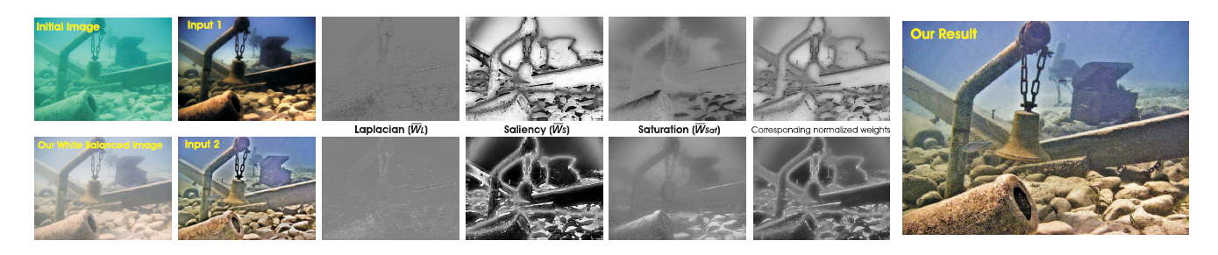
In our model for each input, the three weight maps are merged in a single weight map as follows. For each input k, an aggregated weight map Wk is first obtained by summing up the three WL , WS, and WSat weight maps. The K aggregated maps are then normalized on a pixel-per-pixel basis. The normalized weights of corresponding weights are shown at the bottom of Fig. 2.4
Figure. 2.4. The two inputs derived from our white balanced image version, the three corresponding normalized weight maps for each of them, the corresponding normalized weight maps and our final result.

Slide 14
2.4 Multi-Scale Fusion Process
The enhanced image version is obtained by fusing the defined inputs with the weight measures at every pixel location.
In our model we are using Pyramid Technique of Multi-Scale Fusion An original image is represented in different levels by forming the pyramid structure. A compound image is created by applying a pattern selective approach of image fusion. Initially, the pyramid decomposition is performed on each source image. All these images are integrated to form a fused resultant image.

Slide 15
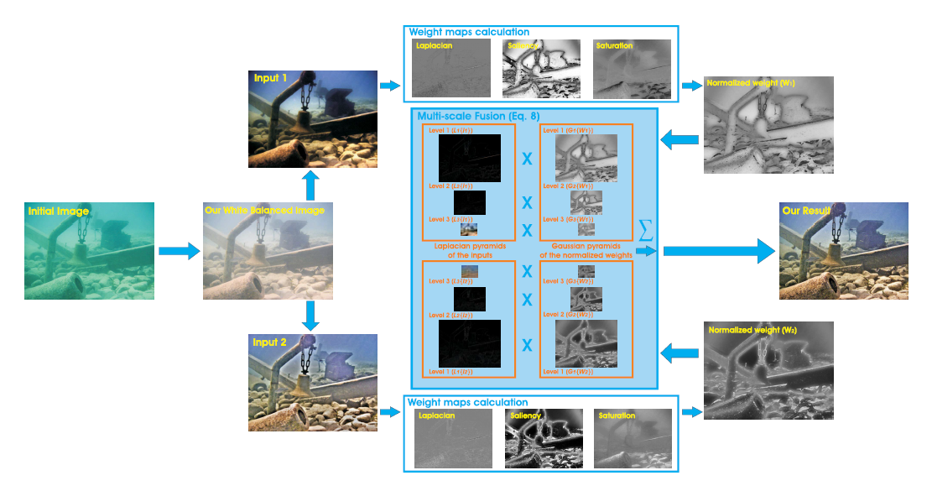
Figure 2.5. Overview of our Algorithms. Two images, denoted Input 1 and Input 2, are derived from the (too pale) white balanced image, using Gamma correction and edge sharpening, respectively. Those two images are then used as inputs of the fusion process, which derives normalized weight maps and blends the inputs based on a multi-scale process. The multi-scale fusion approach is here exemplified with only three levels of the Laplacian and Gaussian pyramids.

Slide 16
Results and Qualitative Analysis
The proposed underwater image enhancement method has no limitation on the resolution of input images. The resolution of the output image is consistent with that of the input image.
Our approach is able to enhance a wide range of underwater images (e.g. different cameras, depths, light conditions) with high accuracy, being able to recover important faded features and edges.
Our Model works good with blue/green colour deviated images that does not mean it can not work on shallow and turbid water images, it can work but there will be some challenges with some type of images.

Slide 17
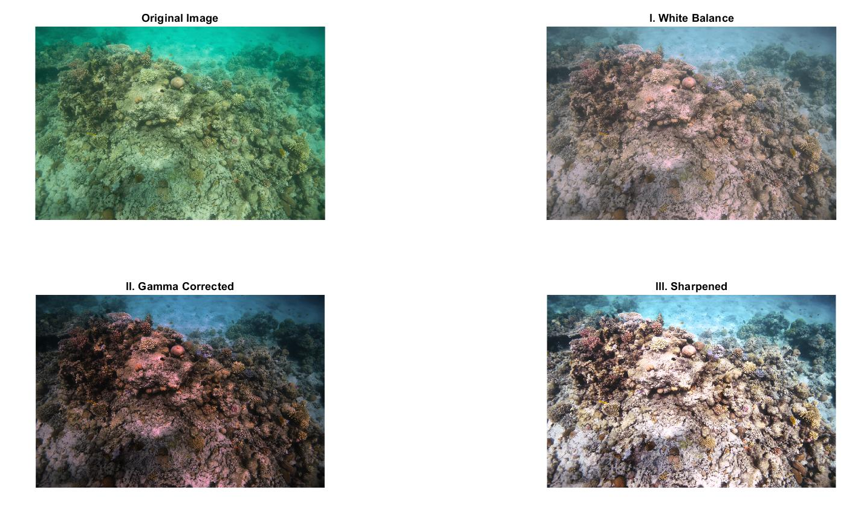
3.1 Some Results of our Model.
Figure3.1 (0). Original Image, (1) . White Balanced Image , (2). Gamma Corrected Image , (3). Sharpened Image

Slide 18
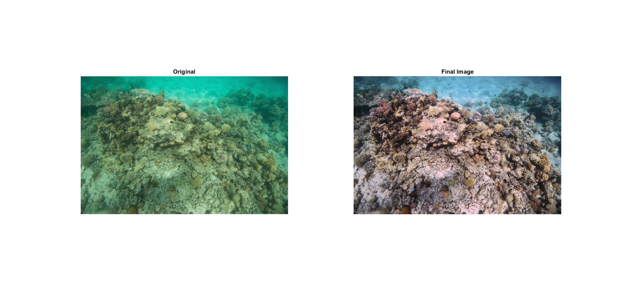
Figure3.2 (Left). Original Image, (Right). Final Enhanced Image

Slide 19
3.2 Qualitative Evaluation
Qualitative evaluation is mainly evaluated in terms of contrast, visibility, and color. Quantitative evaluation is mainly evaluated in terms of underwater image quality measure (UIQM) and underwater color image quality evaluation (UCIQE) .
The UIQM and UCIQE metrics are dedicated to underwater image assessment. They address three important criteria: colorfulness, sharpness, and contrast. In our model we are basically focusing on the blue/green deviated underwater images.
More the value of UCIQE and UIQM more better-quality output image will be.
A comparison of outputs of different present approaches is compared in the fig.3.3 with our work and based on the output images a quality evaluation table 3.1 is made.

Slide 20
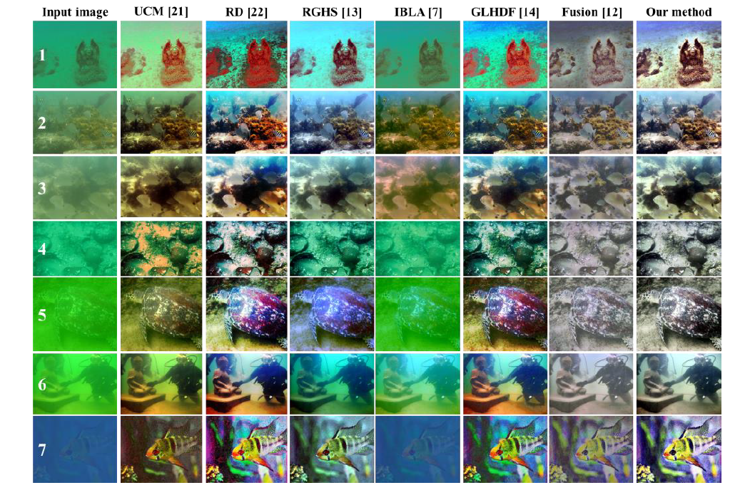
Figure 3.3. The qualitative evaluation result of 7 selected images from a data set.

Slide 21
Table 3.1 : Evaluation of the quantitative quality of the restored underwater images in terms of UCIQE and UIQM .
IBLA [7]
Fusion [12]
RGHS [13]
H&R [15]
Our Model
Data | UCIQE | UIQM | UCIQE | UIQM | UCIQE | UIQM | UCIQE | UIQM | UCIQE | UIQM
1 | 13.808 | 2.386 | 15.905 | 2.494 | 31.028 | 2.273 | 31.477 | 2.499 | 32.847 | 4.640
2 | 28.186 | 2.419 | 18.166 | 3.139 | 31.589 | 3.091 | 31.189 | 3.213 | 31.766 | 4.290
3 | 20.676 | 2.676 | 14.192 | 3.048 | 30.180 | 3.142 | 30.207 | 3.135 | 31.009 | 4.489
4 | 13.040 | 1.914 | 13.343 | 3.201 | 30.315 | 2.048 | 29.357 | 3.190 | 29.366 | 4.990
5 | 17.175 | 1.636 | 12.406 | 2.992 | 30.859 | 2.254 | 29.697 | 2.750 | 29.362 | 4.824
6 | 17.076 | 2.502 | 13.667 | 2.897 | 31.491 | 2.034 | 29.289 | 2.880 | 30.184 | 4.098
7 | 8.190 | 1.713 | 16.604 | 1.756 | 32.355 | 1.629 | 34.998 | 1.660 | 35.259 | 4.023
Average | 16.879 | 2.178 | 14.898 | 2.790 | 31.116 | 2.353 | 30.888 | 2.761 | 31.400 | 4.480

Slide 22
Applications
In marine resource exploration, environmental protection, maritime defense and military affairs, etc.
In Marine Biology to Study different Sea water organisms.
In Archaeological study and Restoration of historical artifacts which are deep down underwater.

Slide 23

5. CONCLUSION
In this project, We have presented an alternative approach to enhance underwater images. Our strategy builds on the fusion principle and does not require additional information than the single original image. We have shown in our experiments that our approach is able to enhance a wide range of underwater images (e.g. different cameras, depths, light conditions) with high accuracy, being able to recover important faded features and edges. Moreover, for the first time, we demonstrate the utility and relevance of the proposed image enhancement technique for several challenging underwater computer vision applications.

Slide 24
REFERENCES
Mazel, C.H. In situ measurement of reflectance and fluorescence spectra to support hyperspectral remote sensing and marine biology research. In Proceedings of the OCEANS 2006, Boston, MA, USA, 18–21 September 2006; pp. 1–4.
Hou, G.J.; Luan, X.; Song, D.L.; Ma, X.Y. Underwater man-made object recognition on the basis of color and shape features. J. Coast. Res. 2016, 32, 1135–1141. [CrossRef]
Foresti, G. Visual inspection of sea bottom structures by an autonomous underwater vehicle. IEEE Trans. Syst. Man Cybern. Part B (Cybernetics) 2001, 31, 691–705. [CrossRef] [PubMed]
Lu, H.; Li, Y.; Zhang, L.; Serikawa, S. Contrast enhancement for images in turbid water. JOSA A 2015, 32, 886–893. [CrossRef]
Lu, H.; Guna, J.; Zhou, Q. Preface: Optical imaging for extreme environment. Opt. Laser Technol. 2019, 110, 1. [CrossRef]
Jaffe, J. Computer modeling and the design of optimal underwater imaging systems. IEEE J. Ocean. Eng. 1990, 15, 101–111.[CrossRef]
Peng, Y.T.; Cosman, P.C. Underwater image restoration based on image blurriness and light absorption. IEEE Trans. Image Process. 2017, 26, 1579–1594. [CrossRef]
Peng, Y.T.; Cao, K.; Cosman, P.C. Generalization of the Dark Channel Prior for Single Image Restoration. IEEE Trans. Image Process. 2018, 27, 2856–2868. [CrossRef] [PubMed]
Wang, Y.; Song, W.; Fortino, G.; Qi, L.-Z.; Zhang, W.; Liotta, A. An Experimental-Based Review of Image Enhancement and Image Restoration Methods for Underwater Imaging. IEEE Access 2019, 7, 140233–140251. [CrossRef]

Slide 25
REFERENCES (Cont.)
Schettini, R.; Corchs, S. Underwater image processing: State of the art of restoration and image enhancement methods. EURASIP J. Adv. Signal Process. 2010, 2010, 1–14. [CrossRef]
Ghani, A.S.A.; Isa, N.A.M. Automatic system for improving underwater image contrast and color through recursive adaptive histogram modification. Comput. Electron. Agric. 2017, 141, 181–195. [CrossRef]
Ancuti, C.O.; Ancuti, C.; De Vleeschouwer, C.; Bekaert, P. Color Balance and Fusion for Underwater Image Enhancement. IEEE rans. Image Process. 2017, 27, 379–393. [CrossRef] [PubMed]
Huang, D.; Wang, Y.; Song, W.; Sequeira, J.; Mavromatis, S. Shallow-water image enhancement using relative global histogramstretching based on adaptive parameter acquisition. In International Conference on Multimedia Modeling; Springer: Cham,Switzerland, 2018; pp. 453–465.
Bai, L.; Zhang,W.; Pan, X.; Zhao, C. Underwater image enhancement based on global and local equalization of histogram and dual-image multi-scale fusion. IEEE Access 2020, 8, 128973–128990. [CrossRef]
Song, H.;Wang, R. Underwater Image Enhancement Based on Multi-Scale Fusion and Global Stretching of Dual-Model.
16. Li, J.; Skinner, K.A.; Eustice, R.M.; Johnson-Roberson, M. WaterGAN: Unsupervised generative network to enable real-time color correction of monocular underwater images. IEEE Robot. Autom. Lett. 2017, 3, 387–394. [CrossRef]
17. Wang, N.; Zhou, Y.; Han, F.; Zhu, H.; Zheng, Y. UWGAN: Underwater GAN for real-world underwater color restoration and dehazing. arXiv 2019, arXiv:1912.10269.
18. Hou, G.; Zhao, X.; Pan, Z.; Yang, H.; Tan, L.; Li, J. Benchmarking Underwater Image Enhancement and Restoration, and Beyond. EEE Access 2020, 8, 122078–122091. [CrossRef]
19. Li, C.; Guo, C.; Ren, W.; Cong, R.; Hou, J.; Kwong, S.; Tao, D. An Underwater Image Enhancement Benchmark Dataset and Beyond. IEEE Trans. Image Process. 2020, 29, 4376–4389. [CrossRef] [PubMed]
20. Anwar, S.; Li, C. Diving deeper into underwater image enhancement: A survey. Signal Process. Image Commun. 2020, 89, 115978. [CrossRef]
21. Iqbal, K.; Odetayo, M.; James, A.; Salam, R.A.; Talib, A.Z.H. Enhancing the low quality images using unsupervised colour correction method. In Proceedings of the 2010 IEEE International Conference on Systems, Man and Cybernetics, Istanbul, Turkey, 10–13 October 2010; pp. 1703–1709.
22. Ghani, A.S.A.; Isa, N.A.M. Underwater image quality enhancement through integrated color model with Rayleigh distribution. Appl. Soft Comput. 2015, 27, 219–230. [CrossRef]
23. Fu, H.; Cao, X.; Tu, Z. Cluster-based co-saliency detection. IEEE Trans. Image Process. 2013, 22, 3766–3778. [CrossRef]

Slide 26

THANK YOU

